Slide 1

Cybersecurity Awareness Chatbot
A Console-based Cybersecurity Assistant
Mudau Khorommbi
04 April 2025

Slide 2

Introduction
The Cybersecurity Awareness Chatbot is a console application built in C#.
It helps users learn about cybersecurity best practices.
Features include ASCII art, personalized greetings, predefined responses, and user-friendly interactions.

Slide 3


Slide 4
Program Structure
The chatbot is implemented in a single class: Program.
Uses various methods for modular functionality.
Key functionalities include:
Displaying ASCII logo
Playing an audio greeting
Interacting with the user
Responding to cybersecurity-related queries

Slide 5
DisplayLogo Method
Displays an ASCII art logo with a border.
Enhances UI with colors and structured formatting.
Highlights branding: "🔒 SECURE BOT 🔒"

Slide 6
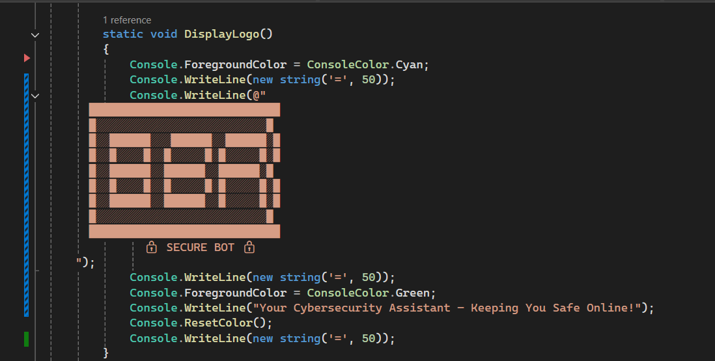

Slide 7


Slide 8
PlayGreeting Method
Attempts to play a greeting audio file.
Uses SoundPlayer class to play a WAV file.
Implements error handling for missing or unreadable files.

Slide 9
GetUserName Method
Prompts the user to enter their name.
Uses a do-while loop to ensure valid input.
Trims unnecessary spaces and prevents empty entries.

Slide 10
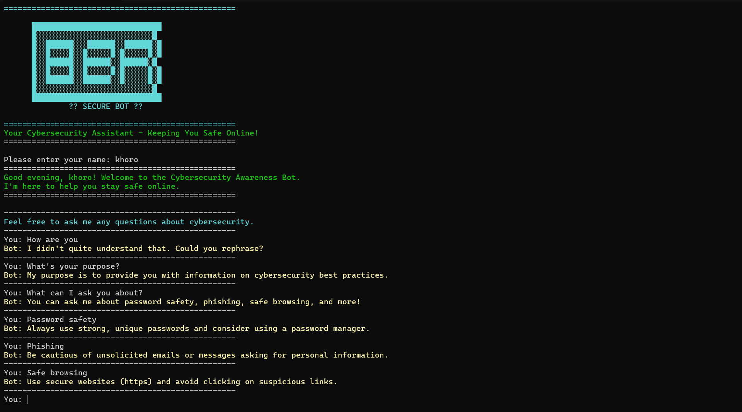

Slide 11
DisplayWelcomeMessage Method
Greets the user with a personalized message.
Dynamically adjusts greeting based on time of day.
Example:
Morning: "Good morning, [User]!"
Evening: "Good evening, [User]!"

Slide 12
StartResponseSystem Method
Guides the conversation with cybersecurity-related topics.
Allows users to input questions.
Checks for empty input and provides helpful responses.

Slide 13
RespondToUser Method
Uses a switch-case structure for predefined responses.
Topics covered:
Password Safety
Phishing Awareness
Safe Browsing Practices
Provides cybersecurity tips in a user-friendly manner.

Slide 14
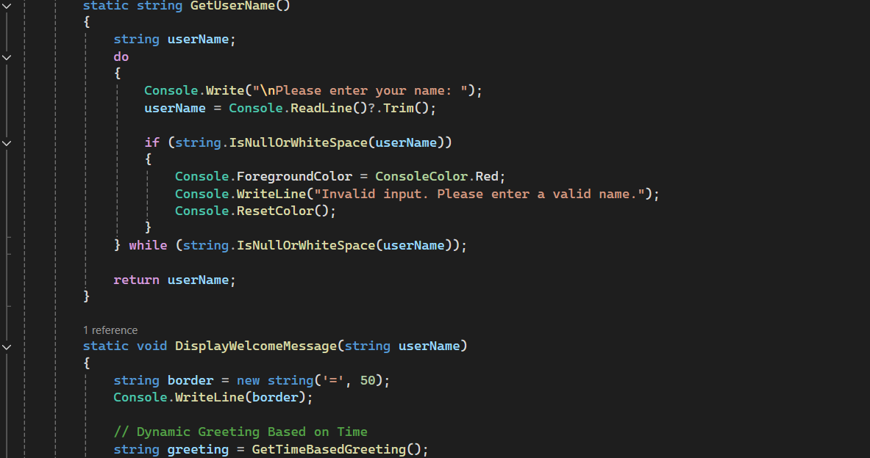

Slide 15
TypingEffect Method
Simulates a typing effect for responses.
Uses Thread.Sleep(50) to create a realistic chatbot feel.
Enhances user engagement.

Slide 16
Key Features
Personalized Interaction: Uses the user’s name.
Predefined Responses: Answers common cybersecurity questions.
Audio Greeting: Enhances the chatbot experience.
User-friendly Console UI: Colored text, borders, dividers.

Slide 17
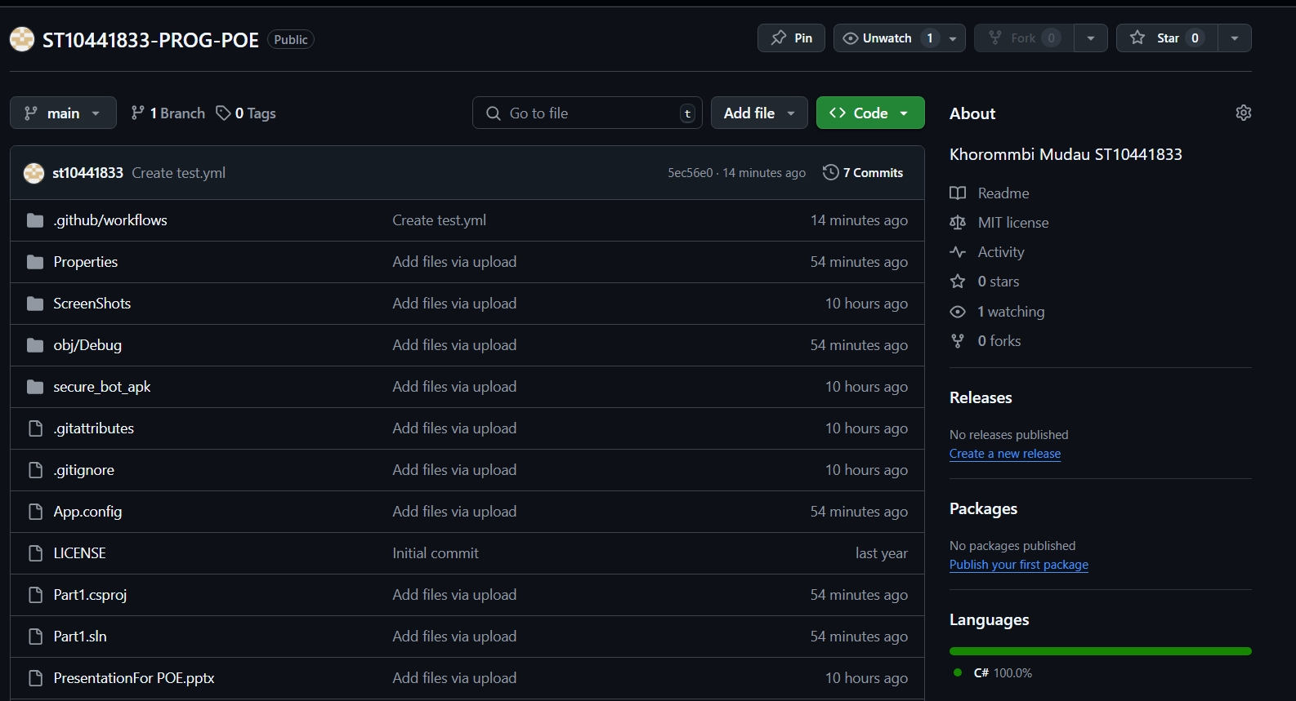

Slide 18
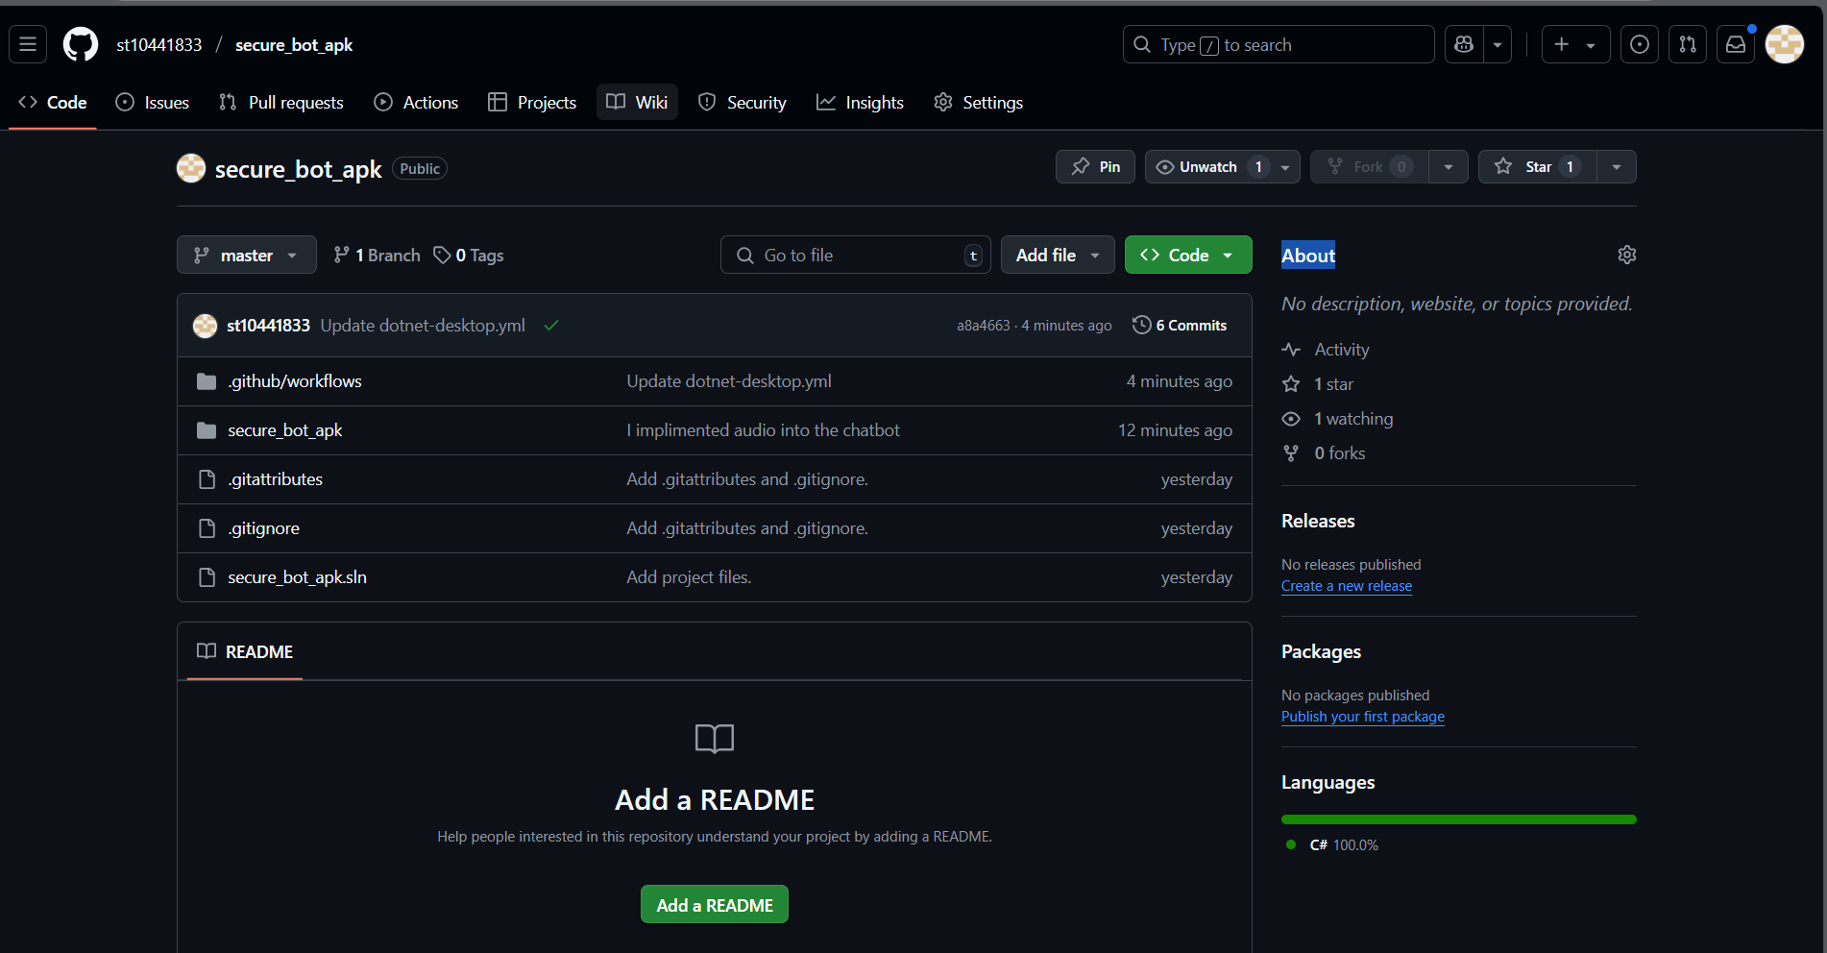

Slide 19
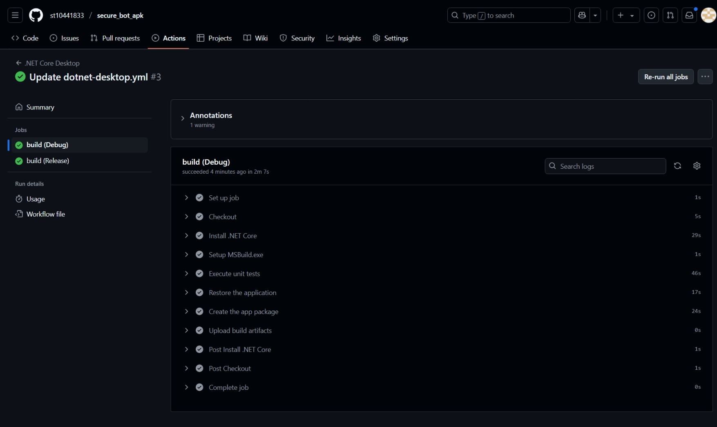

Slide 20
Conclusion
The chatbot is a simple yet effective tool for raising cybersecurity awareness.
Uses fundamental C# programming concepts like:
String manipulation
Conditional statements
Error handling

